Slide 1

The Copernican Revolution

Slide 2
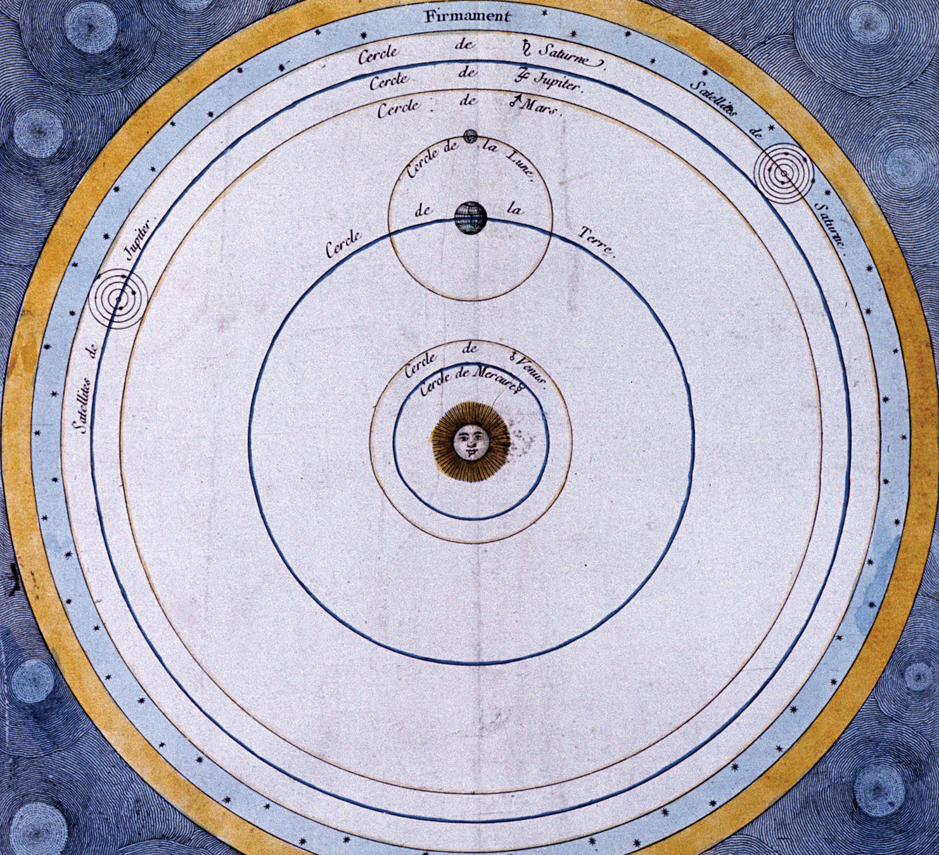
The Copernican System

Slide 3
Commentariolus (161)
7 central theses:
No one center of all the celestial spheres. The Earth is the center of the lunar orbit; the Sun is the center of the planetary orbits.
The Earth is the center of gravity but not of the world. Obvious issue with physics.
The planetary spheres revolve around the Sun at the center. Here he advances a clearly heliocentric model, but later will move the Sun ouf of the center and replace it with a heliostatic model. Most importantly, here he treats the Earth as just another planet, exploding the received distinction between a star and a planet.

Slide 4
Commentariolus (con’t)
The distance of the Earth from the Sun is INCOMMENSURABLE with the dimensions of the firmament. By attributing the Sun’s motion to the Earth, Copernicus is under no constraint to hold that the cosmos is small. Just how big is he cosmos? Well, it can’t be infinite but it can be as big as it needs to be.
Stellar parallax. Lack of this was used by Copernicus as evidence for a large cosmos. It was used by his opponents to suggest that the Earth can’t be in motion at all.
Think about the Earth’s motion is an immense universe. It is not really going anywhere; it is hardly moving at all. An angel on the edge of the cosmos would see the Earth as a blemish on the surface of the Sun.

Slide 5
Commentariolus (con’t)
The Earth performs more than one motion – annual revolution around the Sun; rotation of its axis’ wobble of its axis to account for the precession of the equinoxes.
The motion of the Earth explains the apparent motion of the heavenly bodies. Gives a clear and natural explanation of retrograde motion.

Slide 6

On the Revolutions of the Heavenly Spheres (1543)
Busied himself collecting data on stellar positions and finished his great work in 1543.
Georg Rheticus visited him and published an account of the Copernican system in 1540 (First Narration). He then convinced Copernicus to publish his great work, which Copernicus was given on his death bed.
Book I presents the propositions of the “Commentariolus” together with the reasons, astro­nomical and geometrical, for accepting them. Book II is devoted to spherical astronomy; Book III, to the length of the year and the orbit of the Earth; Book IV, to the Moon and its eclipses; Books V and VI, to the planetary motions.
The work did not immediately win readers. Twenty years passed before a second printing appeared (Basel, 1566), and another fifty before there was a third (1617). Even today, the complete work is not available in English. Yet in this long-neglected book Copernicus, almost single-handed, overthrew the old geocentric theory and established a heliocentric astronomy in its place. Some of his “proofs” are now outmoded, chiefly because Copernicus had to rely upon observations and measurements made with the crudest of instruments. Some of his hypotheses later generations of astro­nomers have refused, notably the one concerning that motion of the Earth which, according to him, explains the precession of the equinoxes which was first detected by

Slide 7
The essential elements that came to be identified with the Copernican system — the abolition of epicycles and deferents, the dissolution of the spheres, the Sun a star, the infinite expansion of the cosmos, easy and accurate computations of planetary position — are not to be found in it. In every respect except the Earth’s motion, the work is closer to ancient texts, especially to Ptolemy’s Almagest. It is at once ancient and modern. It is conservative and radical. In retrospect, we can state that the significance of De Revolutionibus consists in what it inspired others to say-- it was a revolution making rather than a revolutionary text. It shifted the direction in which scientific thought developed.
Though it is modeled on Ptolemy’s Almagest, De Revolutionibus takes the bold step of rejecting the Ptolemaic system because, as Copernicus says in the Preface of his great work, it leads to great inaccuracies in prediction. It was the concerted way that Copernicus investigated the mathematical consequences of the Earth’s motion and worked to reconcile these with extant astronomical knowledge that was the heart of his revolutionary work (Kuhn 1957: 184). The Copernican revolution was not a revolution in the techniques to compute planetary position but it began as one.

Slide 8

Copernicus as a revolutionary?
In technical respects, Copernicus was traditional. He argued, for example, that only a uniform circular motion or a combination of such motions could account for the celestial phenomena. He was even more Aristotelian than others in his rejection of the equant — Copernicus would not consent to the violation of uniform and systematic motion of a sphere that is implicit in the use of an equant. However, his central argument for a moving Earth was based on his roots in tradition; i.e., because the Earth is a sphere, it too must participate in the compounded circular motions that, he contended, are natural to a sphere.
The message here is that we can have an Aristotelian universe and transpose the motions of the Sun and the Earth. According to Copernicus, all matter, celestial and terrestrial, aggregates naturally into spheres. The spheres then rotate of their own nature. A bit of matter separated from its natural position will continue to rotate with its sphere.

Slide 9
Difficulties for Copernicus’ Theory
It was inconsistent with the dominant physics of the day — it presumed, for example, that there were two different centers of rotation. To complicate matters, Copernicus had no physics of a moving Earth. He did not conceive the Earth’s motion for physical reasons. (Kepler, Galileo, Descartes, and Newton worked hard to erase this inconsistency. We will examine their views in the coming chapters.)
Copernicus contended that it was somehow more natural to have the Sun, which he thought of as a unique celestial body at the centre of things, and the Earth as a planet. In terms of our present view, this arrangement makes a great deal of sense — we know that the Sun, which is a source of heat and light for the entire planetary system, is a different kind of body than the Earth or any of the other planets. The Copernican system afforded a different kind of anatomy of celestial bodies, one that made a clear distinction planets and fixed stars with the Sun as one of the fixed stars. The obvious objection, however, was that if the Earth is a planet, like the other planets wandering through space, it seems clear that we should have a physics for a moving Earth. And there was no physics; i.e., there was no explanation as to how it is that the Earth, a massive body, can be set in motion throughout space.

Slide 10
The Copernican System as a Physical System
Copernicus maintained that the motion of the Earth is real; that is, the Earth is a physical body that moves through real physical space. It was very difficult to reconcile this suggestion with the many epicycles and deferents that appear in Copernicus’ planetary constructions. Although Copernicus meant to describe and give a physical account of the planetary system with the Earth as a body moving through space, he was compelled to use purely geometrical constructions to account for astronomical phenomena. These two things did not fit well together.

Slide 11
Copernicus and the Church
For a nearly a half century, the religious implications of the Copernican system were overlooked and, in retrospect, there is a very obvious reason why. Few people read Copernicus’s great work and the majority of those who studied it carefully were astronomers working in the service of the Church. These astronomers persisted, with Osiander, in regarding the Copernican system as just a mathematical construction that makes no connection with reality. It is only when these physical questions are taken seriously that unwelcome religious implications for orthodox views are raised.

Slide 12
Copernicus and Common Sense
It’s evident to anyone that the Earth is not in motion; indeed, that it can’t possibly be in motion. We feel a horse in motion, and the faster we move, the more we feel the force of resistance against our skin. We certainly don’t feel the Earth moving, and most assuredly not at the tremendous speed called for by Copernicus’ claim that it revolves around the Sun every year. Though the Earth is supposed to move thousands and thousands of miles each second, we feel nothing. The clouds apparently feel nothing either. They just keep going around the Earth; they are not swept away. And the atmosphere, which is so incredibly light and airy that we can put our hand through it, is not swept away by the violent motion. So, which side do we take here? Common sense says the Earth is not in motion. Copernicus says that it is in motion. If we side with Copernicus, we run up against common sense.

Slide 13
The Relativity of Motion
It was Galileo who first attempted to defend Copernicus against this argument by advancing a principle of the relativity of motion, which was first described in his Dialogue Concerning the Two Chief World Systems (1632). Using the example of ship travelling Galileo reasoned that at constant velocity, without rocking, on a smooth sea, any observer carrying out experiments below the deck would not be able to tell whether the ship was moving or stationary. The fact that the Earth orbits around the sun at approximately 30 km/s offers a somewhat more dramatic example: it is technically an inertial frame, and according to Galileo’s principle, the laws of motion are the same in all inertial frames.

Slide 14
The New Astronomy and Common Sense
Is science really an intellec­tual representation of the truths that are manifest to us in ordinary experience. Copernicus’ view seemed to suggest the opposite, namely, that science is opposed to common sense. Common sense deceives us. Ordinary sensation misleads us. We need to investigate experience more carefully — perhaps even conduct some experiments — because our folk wisdom cannot be trusted. This is the first scientific theory that aligned itself against common sense and thereby at one and the same time against the wisdom of the ancients and the common sense of the ordinary person. And by standing against the ordinary person, Copernicus seemed to be saying science demands a specialized kind of knowledge.

Slide 15
Stellar Parallax (again)
Stellar parallax is the apparent displacement of an observed object due to a change in the position of the observer. If there stars are situated at enormous distances, as called for by Copernicus. This angle should be measurable, in principle, which would constitute direct empirical evidence produced by measurement of the movement of the Earth through space, as stipulated by the Copernican system.
Stellar parallax was not measurable in the early modern period and would not be measured until 1838 by Bessel, using an improved heliometer (telescope with a split objective lens).

Slide 16
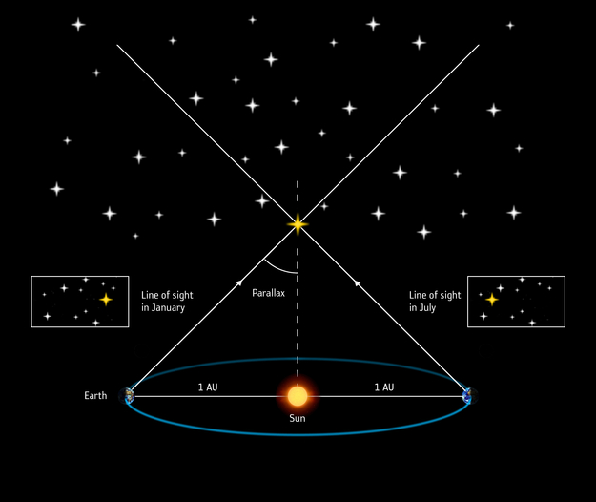
Measuring stellar parallax

Slide 17
The Status of the Sun
In the Copernican system, the Sun has no status at all — it is not a planet but motionless. It is not a center of planetary motions. At least in the Ptolemaic scheme, the Earth played a vital role as the hub about which the entire mechanism of the heavens turned. Copernicus retained the central role for the Earth, since even the planes of the planetary orbits oscillate in space according to the position of the Earth. The year, that is, the duration of the Earth’s complete revolution around the Sun, has a decisive influence on the motions of the other planets. In short, the Earth appears equal in importance in governing the solar system and the Sun itself, and in fact is nearly as important as in the Ptolemaic system.

Slide 18
Parsimony
The Copernican system gives a simpler picture of such phenomena as retrogradation, but it is not as simple with respect to its geometrical structure. Copernicus had to reintroduce circles to compensate for the abolition of Ptolemy’s equant and for the supposed fluctuation in the rate of the precession of the equinoxes. One commentator counts 48 Copernican circles, whereas the Ptolemaic system required 40 circles. Copernicus did not reduce the number of circles but actually increased them.

